Slide 1
Promising Round trips in the U.S.
Keming Wu
Estimated time: 20 mins

Slide 2
Project Background
Our client is considering entering the U.S. market by starting with 5 round trip routes between medium and large US airports.
Punctuality is a big part of its brand image.

Slide 3
01
Table of contents
02
Data Preprocessing
02
Table join &
Feature engineering
03
Data Analysis
04
Recommendation

Slide 4
01
Data Preprocessing

Slide 5
Dataset Overview
Flights
FL_DATE
OP_CARRIER
TAIL_NUM
OP_CARRIER_FL_NUM
ORIGIN_AIRPORT_ID
ORIGIN
ORIGIN_CITY_NAME
DEST_AIRPORT_ID
DESTINATION
DEST_CITY_NAME
DEP_DELAY
ARR_DELAY
CANCELLED
AIR_TIME
DISTANCE
OCCUPANCY_RATE
Tickets
ITIN_ID
YEAR
QUARTER
ORIGIN
ORIGIN_COUNTRY
ORIGIN_STATE_ABR
ORIGIN_STATE_NM
ROUNDTRIP
REPORTING_CARRIER
PASSENGERS
ITIN_FARE
DESTINATION
Airport Codes
TYPE
NAME
ELEVATION_FT
CONTINENT
ISO_COUNTRY
MUNICIPALITY
IATA_CODE
COORDINATES

Slide 6
Filter Out Target Data
For rows:
1. Drop duplicates
2. Problem Requirements: # 1. Only analyze medium and large airport # 2. Target market is in the US # 3. Only analyze round trip # 4. Exclude canceled flights from these calculations # 5. Each plane can accommodate up to 200 passengers
For columns:
Select only columns we highlighted, drop the rest of the redundant information

Slide 7
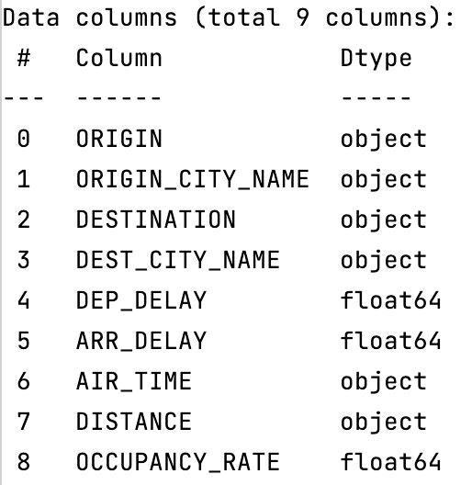
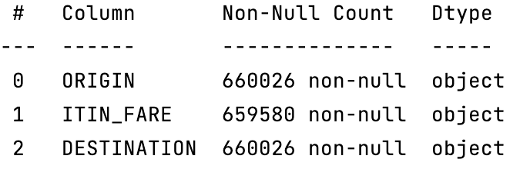
Unclean Data & Data Type
Text or symbols inside the calculation field:
“$$$”
“Hundred”
Data type issues:

Slide 8
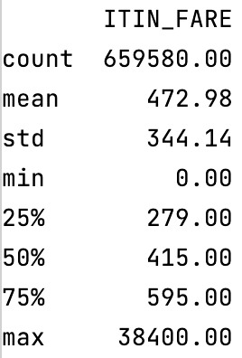
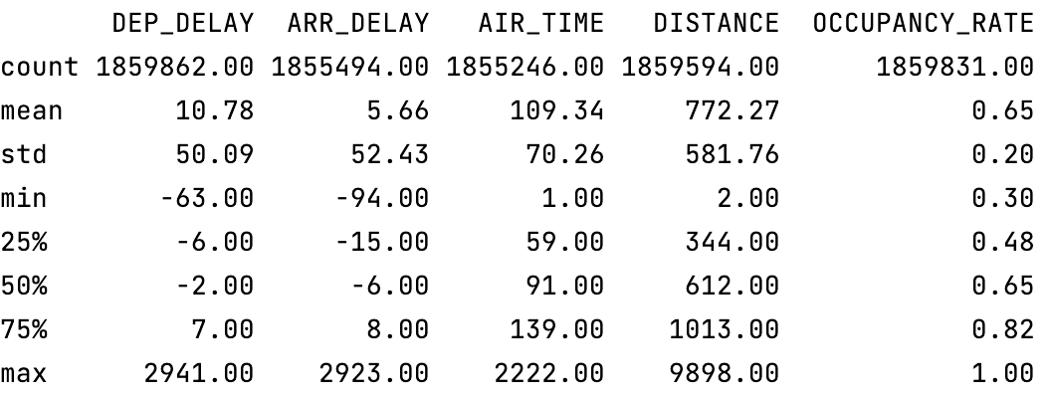
Outlier & Null Value

Slide 9
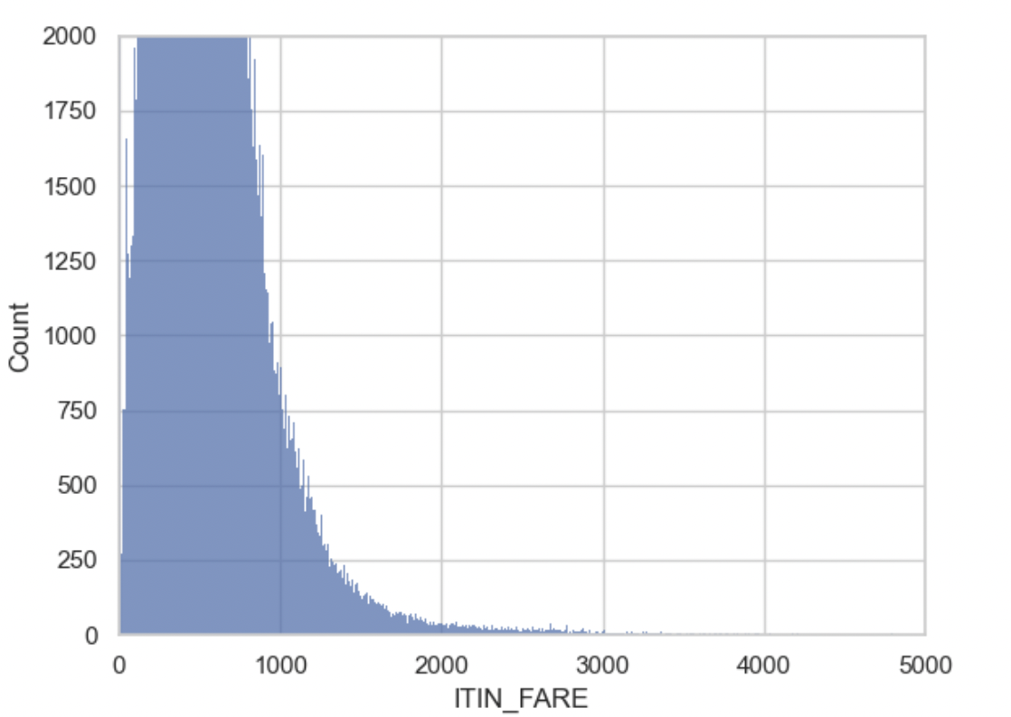
Outlier & Null Value
Reasonable range: [25, 2000]

Slide 10
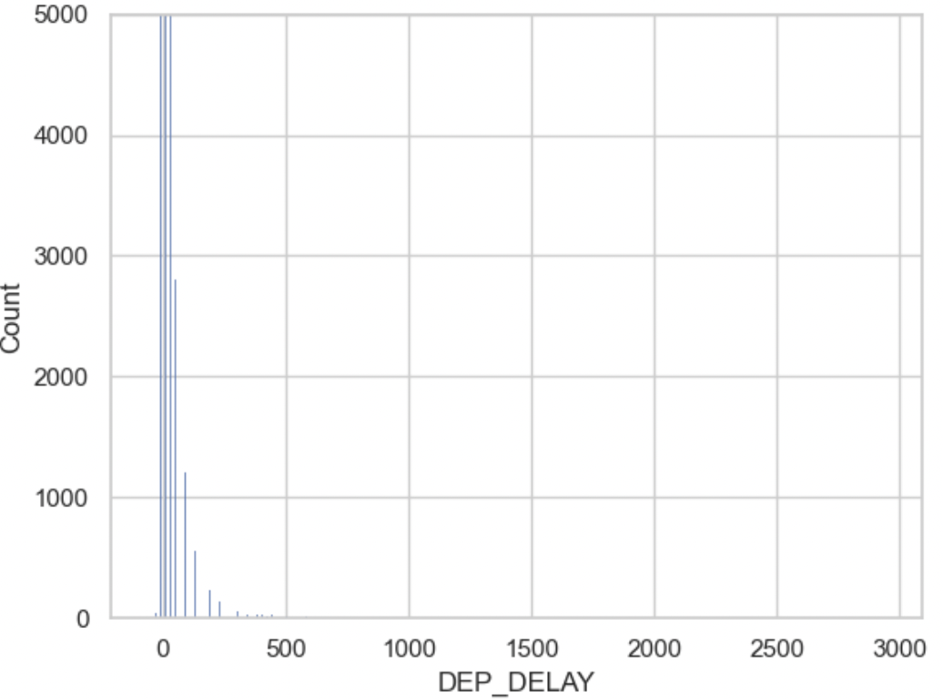
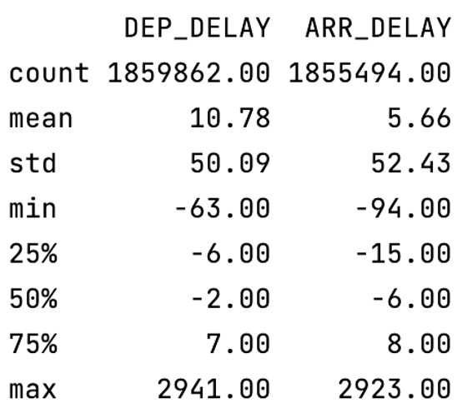
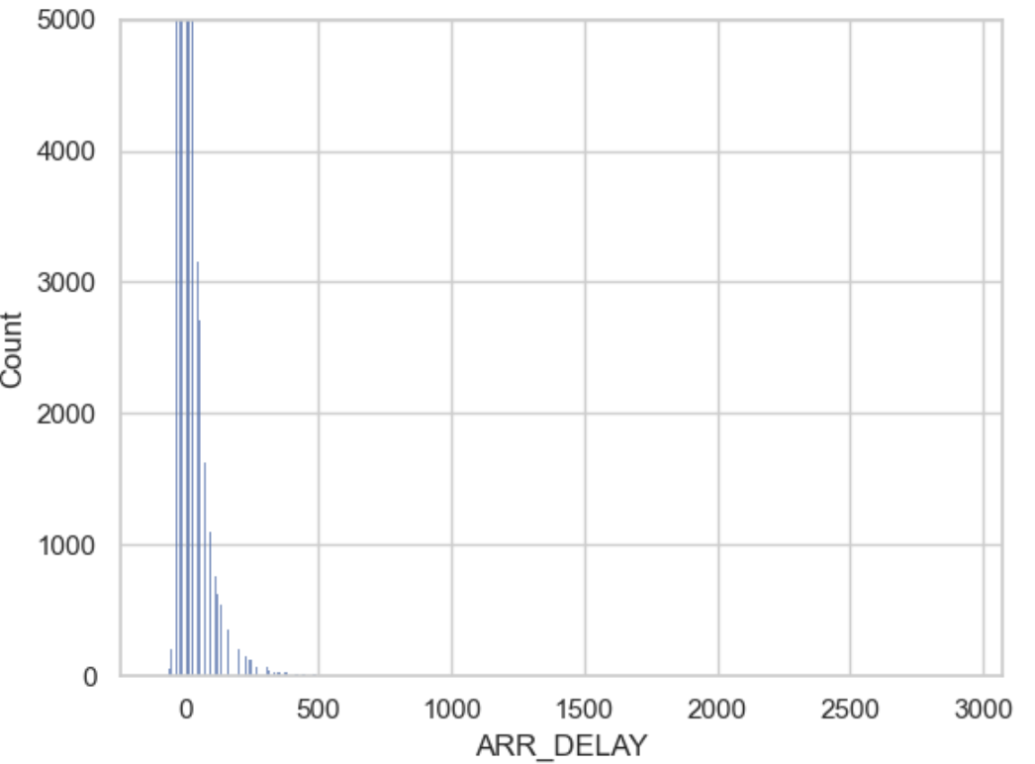
Outlier & Null Value
Reasonable dep range: [-10, 480]
Reasonable arr range: [-60, 480]

Slide 11
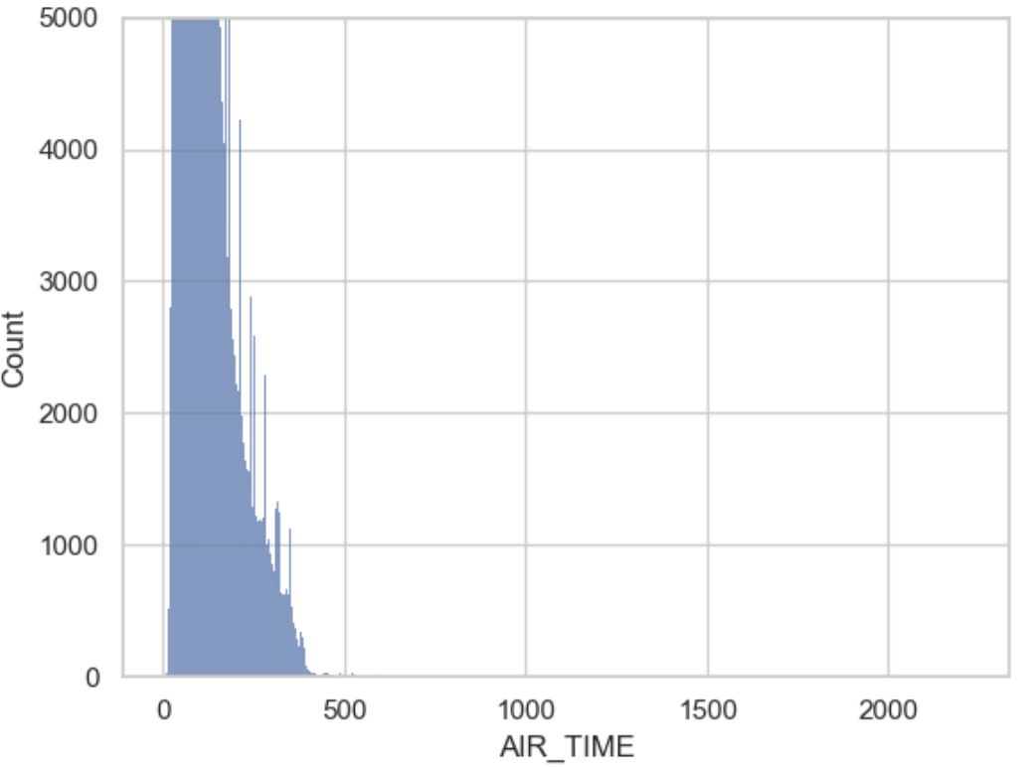
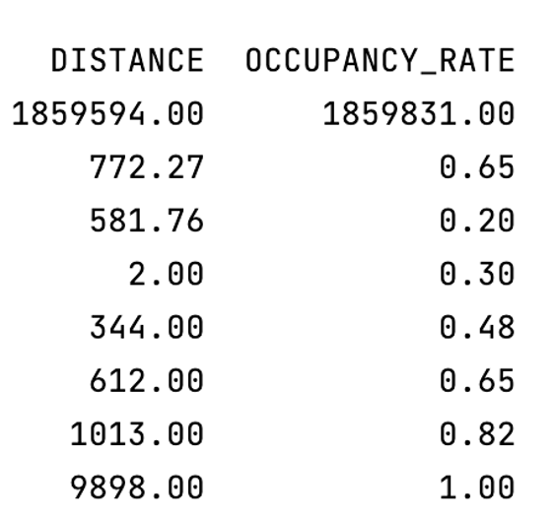
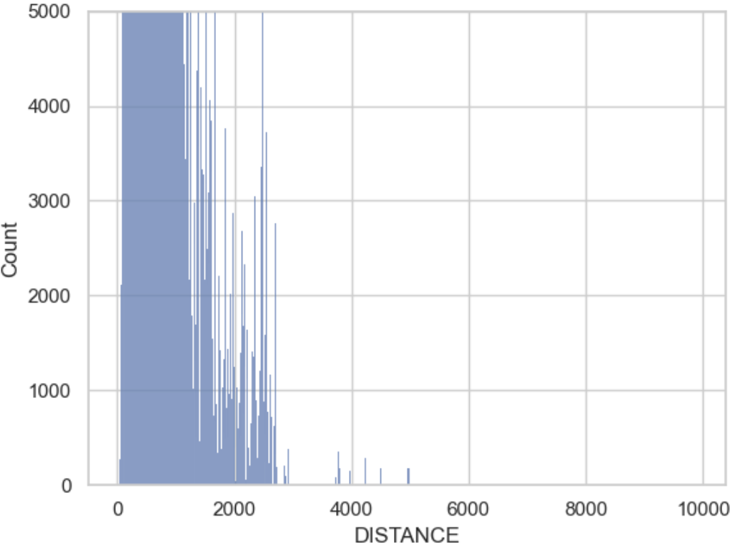
Outlier & Null Value
Reasonable time range: [15, 700]
Reasonable distance range: [31, 5100]

Slide 12
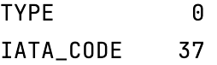
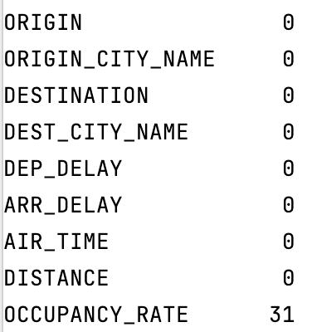
Outlier & Null Value
Airport Code
Flights

Slide 13
Aggregate Ticket Price
Ticket (Before)
Ticket (After)
ORIGIN | DESTINATION | FARE
A | B | 430
A | B | 500
C | D | 246
C | D | 332
ORIGIN | DESTINATION | FARE
A | B | 465
C | D | 289

Slide 14
02
Table join & Feature engineering

Slide 15
Table Join
Flight
ORIGIN | DESTINATION | ARR_TIME | DEP_TIME | …….
A | B | 5 | 7 | ……
C | D | -2 | 2 | ……
ORIGIN | DESTINATION | ARR_TIME | DEP_TIME | TYPE | …….
A | B | 5 | 7 | large | ……
C | D | -2 | 2 | medium | ……
Left join Airport Code
ORIGIN | DESTINATION | ARR_TIME | DEP_TIME | TYPE | ITIN_FARE | …….
A | B | 5 | 7 | large | 465 | ……
C | D | -2 | 2 | medium | 289 | ……
Left join Tickets

Slide 16
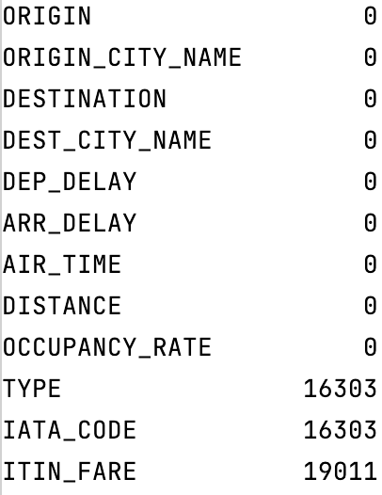
Null Value for Merged data

Slide 17
Feature Engineering
Additional features we need or interested in for the following calculation and analysis # 1. Passenger number
# 2. Flight speed
# 3. On-time percentage for each route
# 4. Average arriving delayed time for each route
# 5. Route trip indicator

Slide 18
Most Important Feature- Round Trip indicator
ORIGIN | DESTINATION | ARR_TIME | DEP_TIME | TYPE | ITIN_FARE | …….
A | B | 5 | 7 | large | 465 | ……
B | A | 4 | 4 | medium | 342
C | D | -2 | 2 | medium | 289 | ……
D | C | 3 | 1 | large | 399
ORIGIN | DESTINATION | ARR_TIME | DEP_TIME | TYPE | ITIN_FARE | ROUND_ROUTE | …….
A | B | 5 | 7 | large | 465 | A-B-A | ……
B | A | 4 | 4 | medium | 342 | A-B-A
C | D | -2 | 2 | medium | 289 | C-D-C | ……
D | C | 3 | 1 | large | 399 | C-D-C

Slide 19
03
Data Analysis

Slide 20
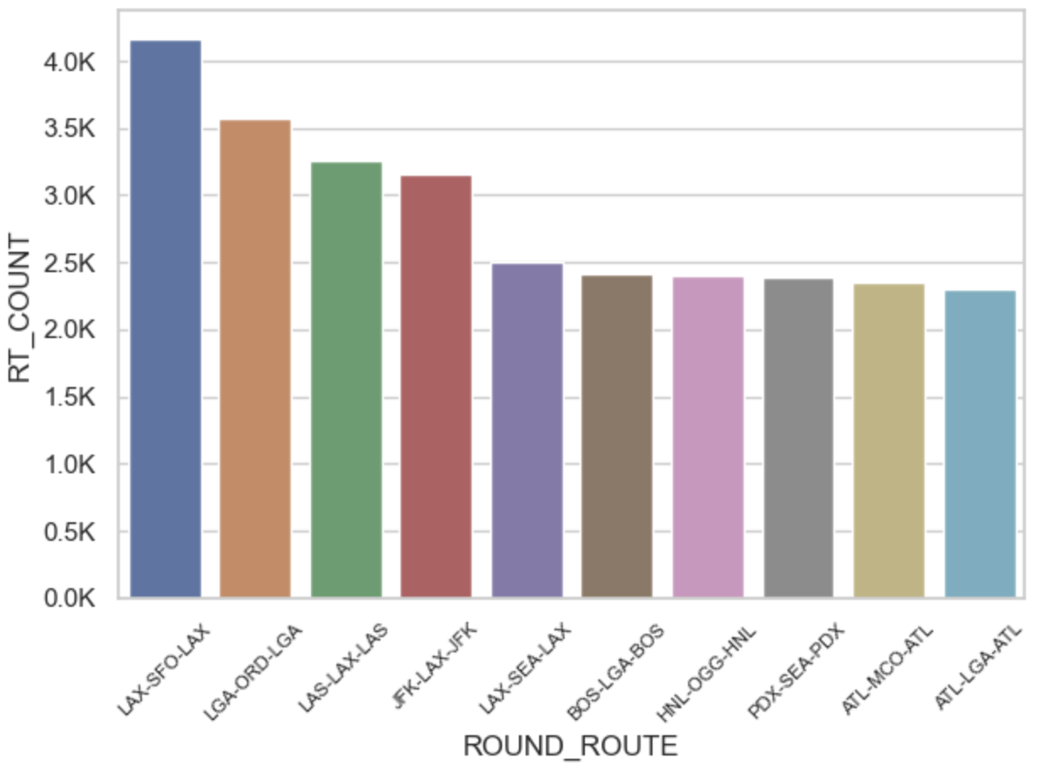
10 Busiest Round Trip
Count number of recodes based on “ROUND_ROUTE” and ***divided by 2***

Slide 21
10 Most Profitable Round Trip
Profit Summary:
Revenue = [ticket revenue] passenger number * ticket price + [baggage fee] 50% * passenger number * 35
Cost = [Fuel, Oil, Maintenance, Crew, Depreciation, Insurance, Other] (8 + 1.18) * distance + [operational cost] 10000 (if it is large airport else 5000) + [delayed cost] 75 * ( (departure delay-15) + (arriving delay-15) if either of them >15 else count them as 0)

Slide 22
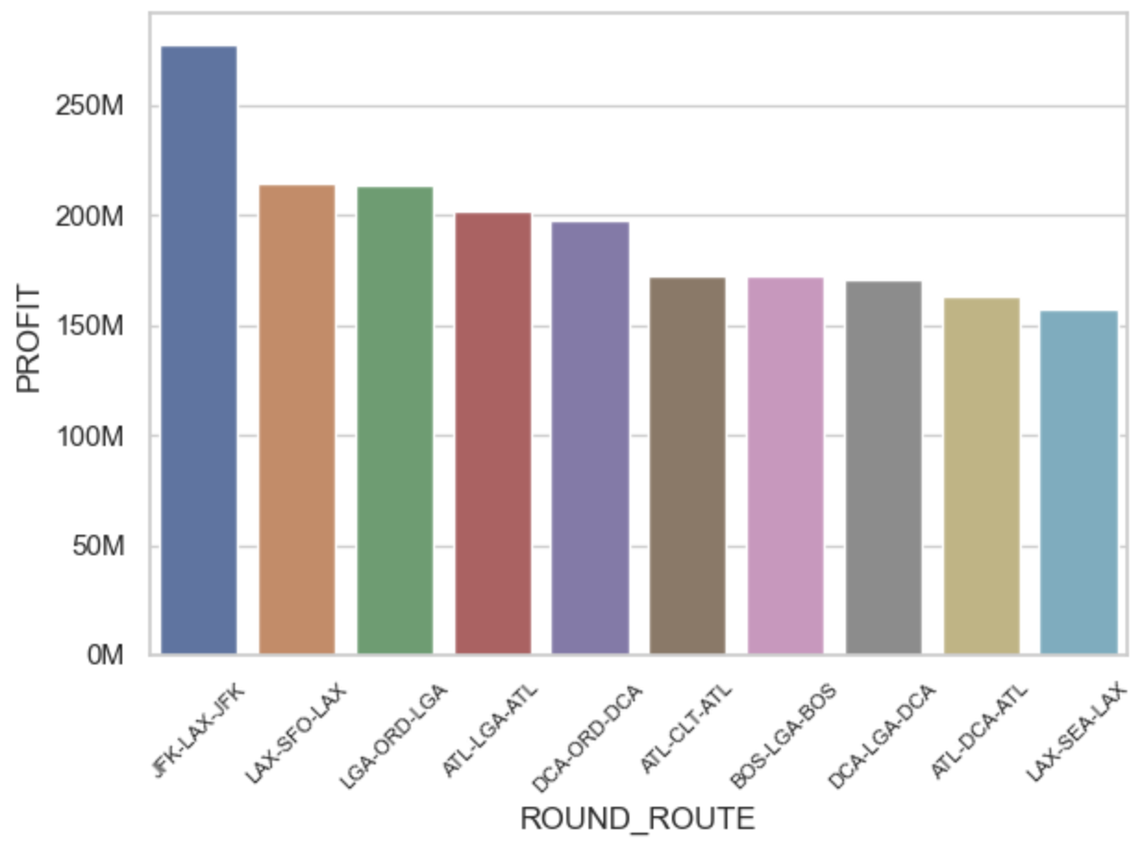
10 Most Profitable Round Trip-Total

Slide 23
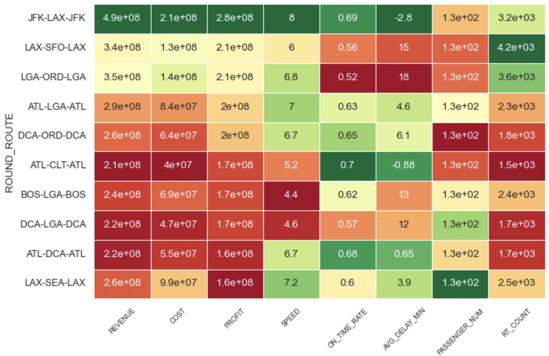
10 Most Profitable Round Trip-Total

Slide 24
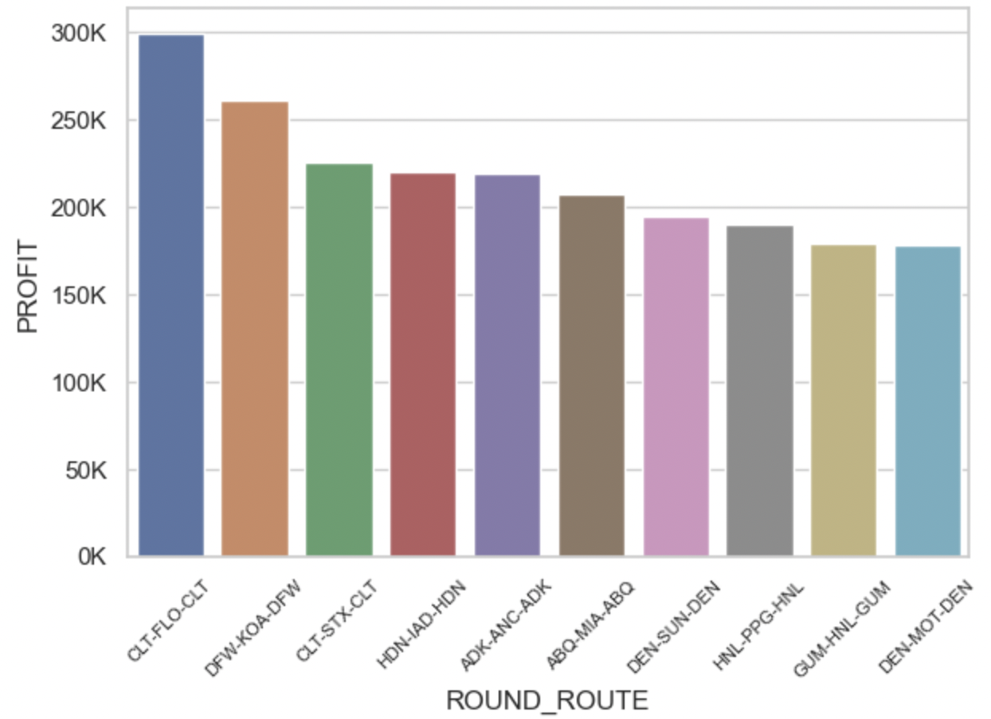
10 Most Profitable Round Trip-Average
One round trip contains two single way trip, so time profit by 2***

Slide 25
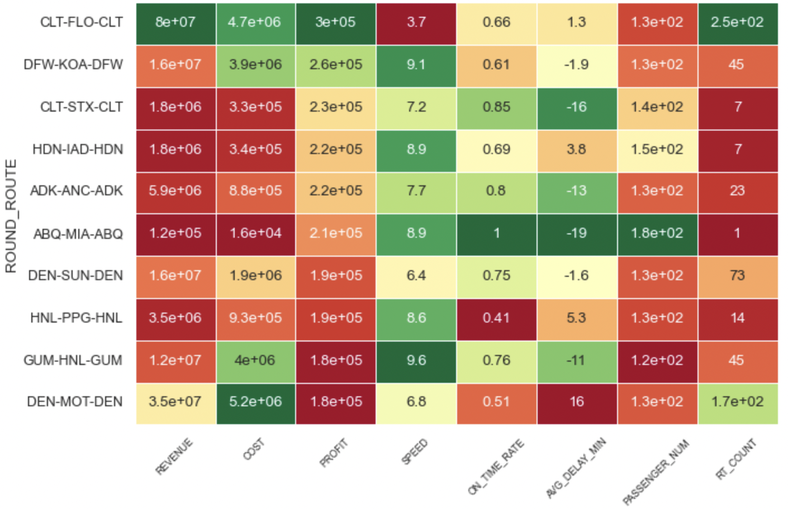
10 Most Profitable Round Trip-Average

Slide 26
04
Recommendation

Slide 27
Score Metrics
Number of flights above average (only as a prerequisite)
On-time rate (35%)
Average delayed time (35%)
Total profit (24%)
Flight speed (6%)
# All metrics were normalized in [0,1] range

Slide 28
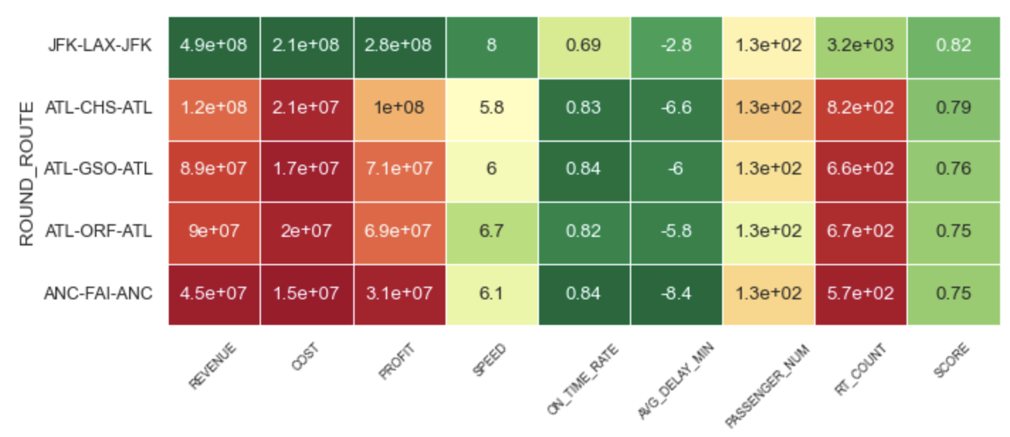
Result

Slide 29
Number of Round Trips to Break Even
Formula: 90000000/ [Average profit per round trip]
The # of round trips it takes for JFK-LAX-JFK to breakeven the upfront airplane cost is: 1023
The # of round trips it takes for ATL-CHS-ATL to breakeven the upfront airplane cost is: 731
The # of round trips it takes for ATL-GSO-ATL to breakeven the upfront airplane cost is: 828
The # of round trips it takes for ATL-ORF-ATL to breakeven the upfront airplane cost is: 868
The # of round trips it takes for ANC-FAI-ANC to breakeven the upfront airplane cost is: 1659

Slide 30
Future KPI’s to Track
Short term KPI # 1. Occupancy rate # 2. Trend(or growth rate) of the occupancy rate # 3. Consumer Satisfaction regarding on-time rate Scaled 1-10 (by questionnaire)
Long term KPI # The long term KPI is to make money # 1. The market share # 2. Annual revenue and profit

Slide 31
Thanks

